Slide 1
Pedi bus
Federico carboni
Shachar oz

Slide 2
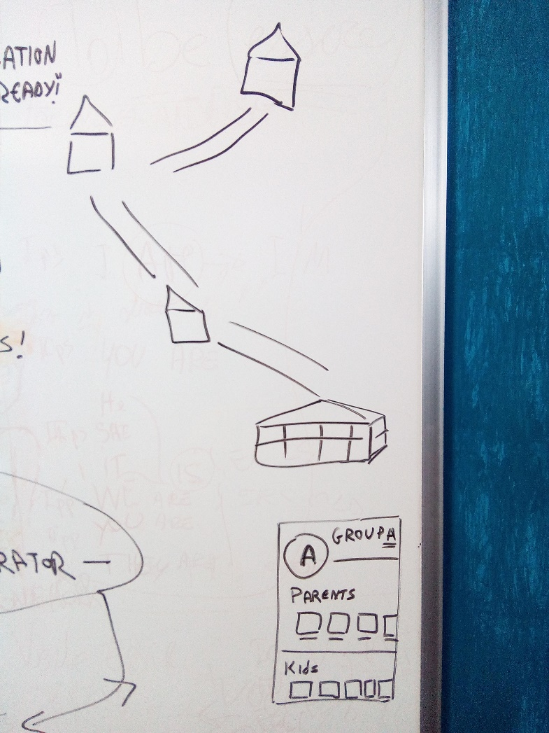
General idea

Slide 3
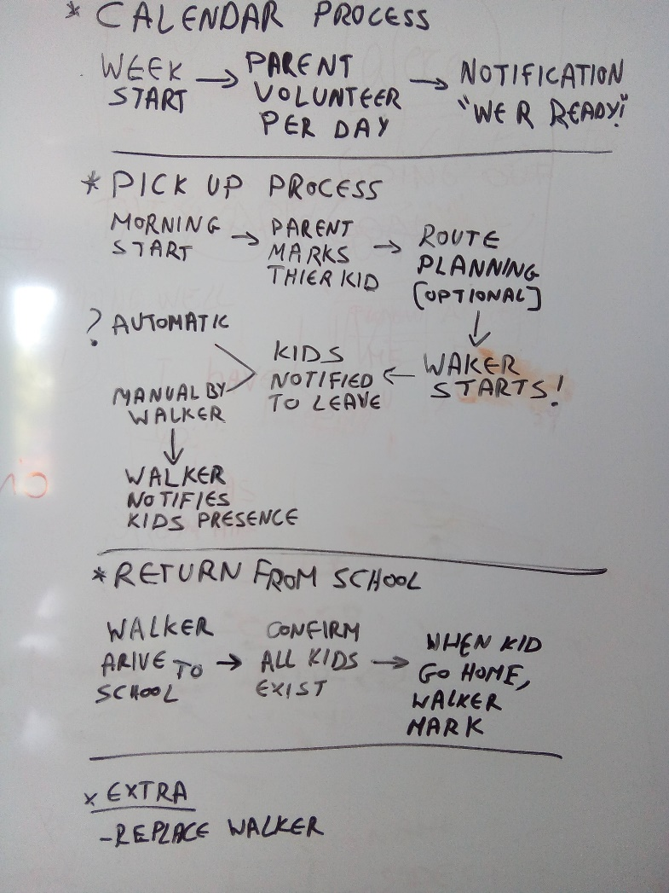
Processes & features

Slide 4
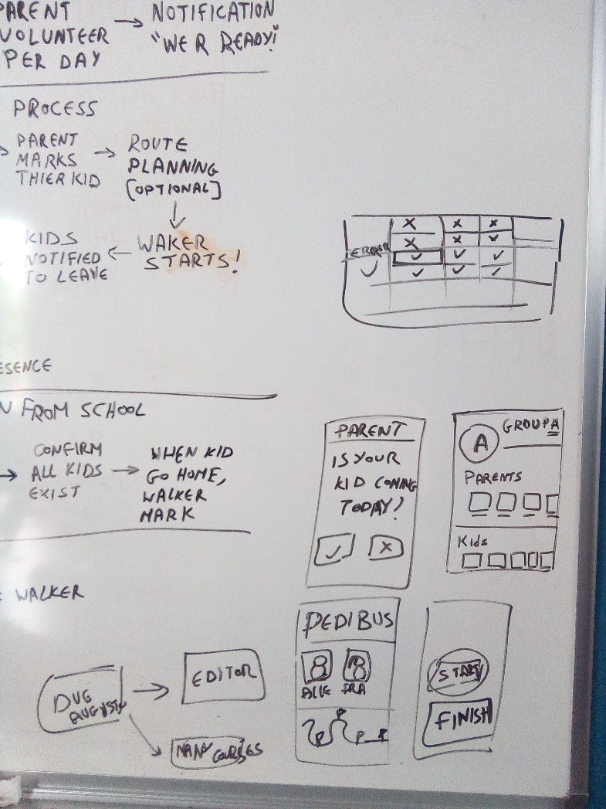
Processes & features

Slide 5
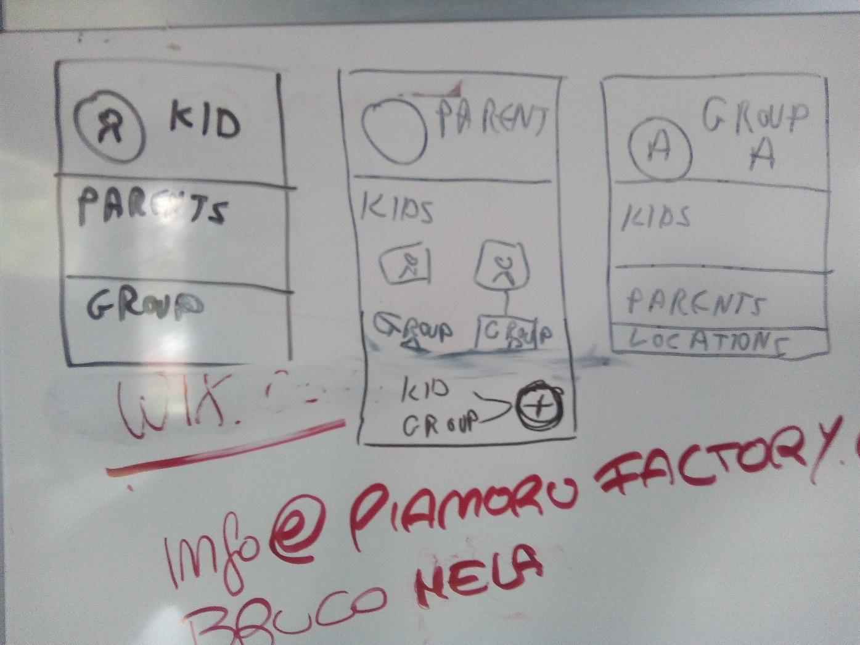
Databases

Slide 6
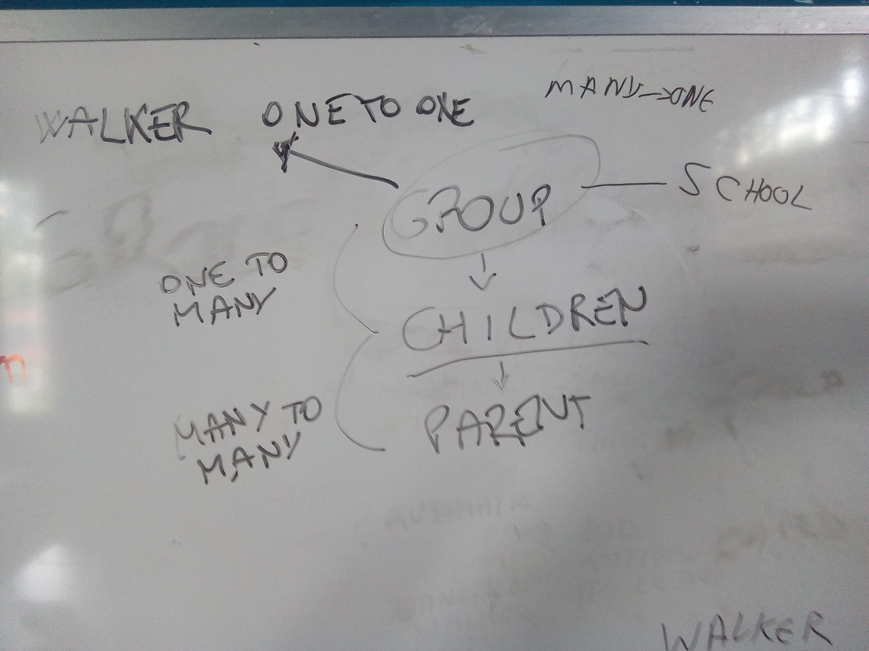
Databases

Slide 7
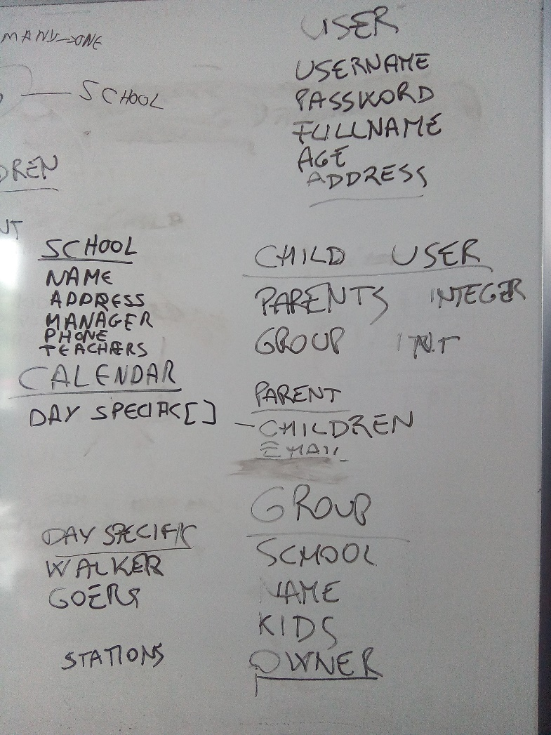
Databases

Slide 8

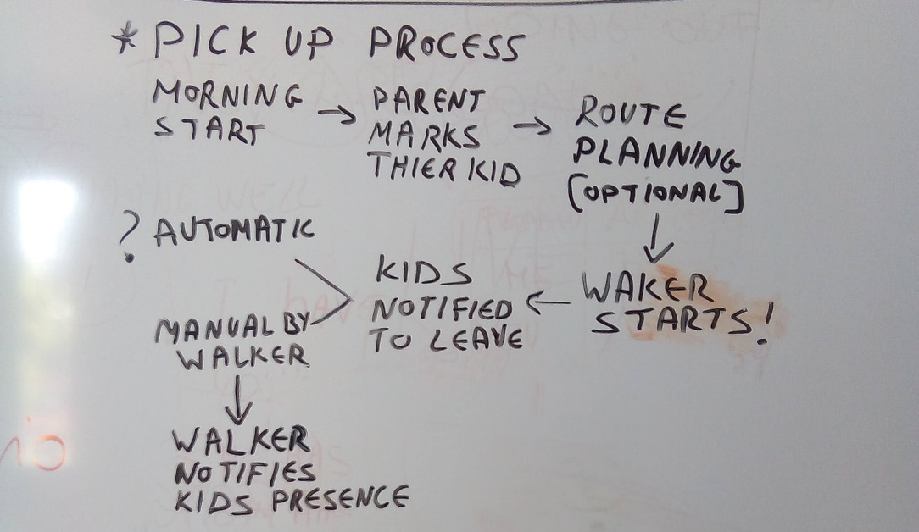
Roadmap + tasks
Registration:
Parent registration
Registering a kid
Adding a group
Adding child to group
Inviting parents to a group
Accepting to join the group
Volunteer to be walker of the day
Morning start
Walker starting the walk to school
Parent marks their kid
Develop the ui of notification for parent about the child participation today
Select whether the child is going with the parent who walks to school
Walker starts
Notify children and parents when the walk starts
Children notify that they’re ready
Kids join the walker
UI for the walker to see the list of children who joined the walk, and a button to end the walk when all kids are ready
Notify kids presence
Walker ticks the kids who joined the walk
Reaching the school
Notify every parent when the walk to school is finished
Mockup focus
OR
MVP- minimum viable product

